Slide 1
Path planning for paths that keep object in sight
Carlos Moro
Ignacio Torroba
Kim Schwaner
Jorge Rodriguez
Notes:
Hi! My name is Jorge and I’m gonna talk about our Project: “Path planning for paths that keep object in sight”

Slide 2
Path planning for paths that keep object in sight
Goal
Status
Project Division
Feature recognition and prediction
Path planning
Plans
FR&P
Path planning
Notes:
For this, I’m gonna divide the presentation in 3 blocks: “Goals, Status and Plans”. Each block will be analized in the right and in the left you will always keep where we are and where we were.

Slide 3
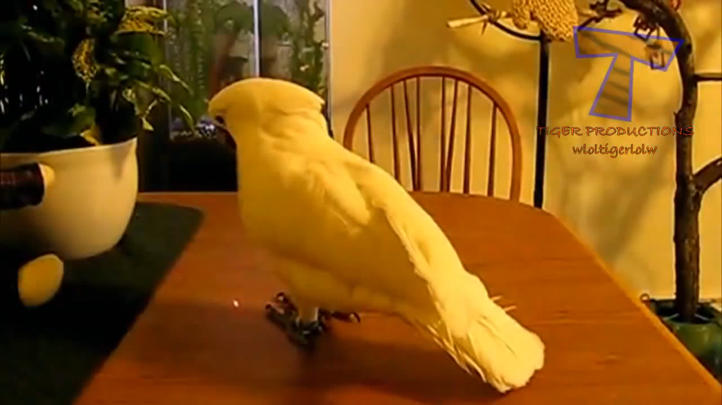
Path planning for paths that keep object in sight
Goal
Status
Project Division
Feature recognition and prediction
Path planning
Plans
FR&P
Path planning
Notes:
To explain what our Project consist of, I thought a video would be better. (Start video) So the idea is that we have something that we want to follow. From this, we are gonna extract a feature that we will keep following and then we will plan a trajectory to keep this feature is sight, as this animal do.

Slide 4
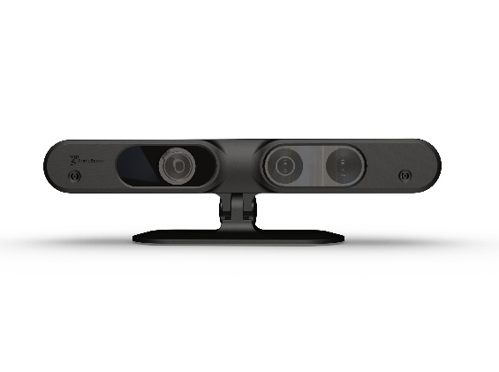
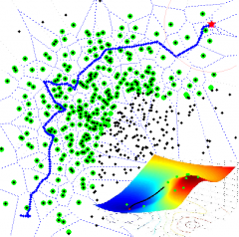
Path planning for paths that keep object in sight
Feature Recognition & Prediction
Path Planning
Goal
Status
Project Division
Feature recognition and prediction
Path planning
Plans
FR&P
Path planning
Notes:
Regarding what we have already done, I’m gonna start talking about how we have divided the project. First a part in which the camera’s images will be received and processed and that will return a point that will be used for the path planning. This division coincide with the number of ROS node to be implemented.

Slide 5
Path planning for paths that keep object in sight
Image
Camera
Point
Feature extraction
Predicted Point
Kalman Filter
Robot’s state
Path planner
Robot
Movement!
Goal
Status
Project Division
Feature recognition and prediction
Path planning
Plans
FR&P
Path planning
Notes:
The process is so: (1) The robot’s camera is going to send the image and (2) this image is going to be read and interpretated by a module which will give a point. (3) This point will be pass through a Kalman filter that will give a predicted point and (4) this will be the point sent to the Path planner that will send a robot’s state to the robot (5) which is supposed to move.

Slide 6
Path planning for paths that keep object in sight
Image
Camera
Point
Feature extraction
Goal
Status
Project Division
Feature recognition and prediction
Path planning
Plans
FR&P
Path planning
Predicted Point
Kalman Filter
Robot’s state
Path planner
Movement!
Robot
Notes:
We have implemented this workflow in two ROS Nodes, so the Feature extraction and the Kalman filter are together and the Path planning is a separated node.

Slide 7
Path planning for paths that keep object in sight
ROS image
Receive ROS image
Translate it to Open CV
Feature detection
Color segmentation
Edge detection
Kalman filter
5 Frame history
Position + Speed
Mass center
Goal
Status
Project Division
Feature recognition and prediction
Path planning
Plans
FR&P
Path planning
Notes:
What we have already done in this module is: (1) Receive the image ROS message and translate it to an Open CV Image. (2) This Open CV image is used to do color segmentation, and then edge detection so we can extract a point with the mass center. (3) This point then, will be estimated in the Kalman filter which use a 5 frame history and a physical model with position and speed.

Slide 8
Path planning for paths that keep object in sight
PRM
Creation of the mesh
A star
Goal
Status
Project Division
Feature recognition and prediction
Path planning
Plans
FR&P
Path planning
Notes:
For the path planning we have the PRM that we implemented for the last mandatory exerceise which consist of the creation of the mesh and our improvement that was the use of the A start algorithm to find the shortest path,

Slide 9
Path planning for paths that keep object in sight
Feature recognition:
3D points
QR Codes?
Face recognition?
Kalman Filter
Acceleration
3D points
Goal
Status
Project Division
Feature recognition and prediction
Path planning
Plans
FR&P
Path planning
Notes:
The plans for the feature recognition and prediction are, (1) first to implement 3D points recognition methods and we have also talk about maybe more complex recognition systems as face recognition or IQ Codes. On the other hand, the Kalman filter will be improved adding acceleration to the physical model and also 3D points prediction.

Slide 10
Path planning for paths that keep object in sight
Path planning
Improve the edge creation
Other than PRM
Path optimization
Constrained planning
Goal
Status
Project Division
Feature recognition and prediction
Path planning
Plans
FR&P
Path planning
Notes:
The plans for the feature recognition and prediction are, (1) first to implement 3D points recognition methods and we have also talk about maybe more complex recognition systems as face recognition or IQ Codes. On the other hand, the Kalman filter will be improved adding acceleration to the physical model and also 3D points prediction.

Slide 11
Path planning for paths that keep object in sight
¿Preguntas?
Questions?
spørgsmål
Goal
Status
Project Division
Feature recognition and prediction
Path planning
Plans
FR&P
Path planning
Notes:
The plans for the feature recognition and prediction are, (1) first to implement 3D points recognition methods and we have also talk about maybe more complex recognition systems as face recognition or IQ Codes. On the other hand, the Kalman filter will be improved adding acceleration to the physical model and also 3D points prediction.

